Slide 1
Stress Effects on Statistical Learning
April 13, 2020

Slide 2
Statistical Learning
Statistical Learning = the ability of the brain to extract statistical regularities to learn generalizable rules about the environment
Traditional memory models suggest that this is supported mainly by the cortex
Recent studies demonstrated that the hippocampus can play a role in rapid statistical learning
Temporal communities are predictable relationships about which stimuli are likely to co-occur
Temporal communities can be used implicitly in event segmentation
Shapes with statistical relationships had more similar patterns of activation in fMRI
The hippocampus was necessary for the formation of community representations

Slide 3
Stress and the Hippocampus
Stress impacts a variety of medial temporal functions
Supportive of generalization during encoding
Often obstructive during retrieval
Can induce need for further evidence accumulation
Predictions
Increased performance for encoding group
Decreased performance for retrieval group
Increased lag in response time for the retrieval group
Notes:
Screen capture of the task

Slide 4
Study Goals
Quantify whether and how acute stress impacts statistical learning
Quantify the relationship between performance on temporal community learning tasks and individual differences
Evaluate the relationship between conscious awareness of statistical relationships and demonstrated implicit learning

Slide 5
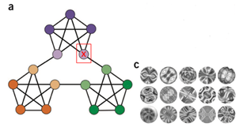
Methodology
Statistical Learning Task
Learning Phase: Subjects see a series of 1400 abstract stimuli, following statistical rules
Retrieval Phase: Subjects see another series of 600 shapes, following the same rules. They are asked to press the spacebar when they feel there is a “natural breaking point” in the sequence
Conscious Awareness Task
Stress Induction Procedure
Salivary Cortisol Measures

Slide 6
Node Selection Measure
Parse on Step 2 would be considered a node response
1
2

Slide 7
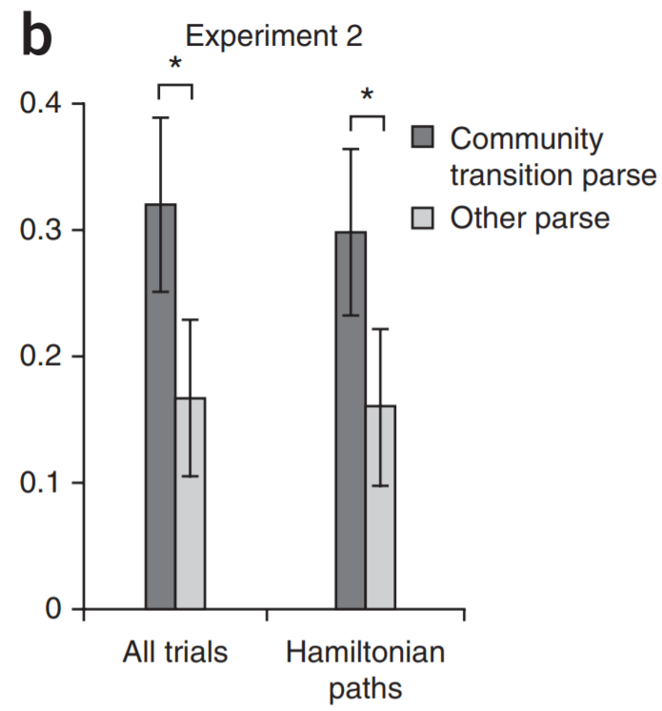
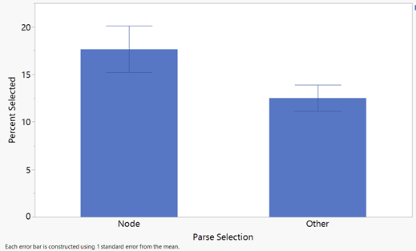
p= 0.038 between node and all other parse selections (for the control group participants specifically)
Trend of implicit learning in control group, though smaller effect than original study

Slide 8
Quantifying Performance
Original study did not specify a single measure of performance
Performance = % selected of nodes - % selected of others
Accounts for difference in proportions of nodes across individuals
Prevents undue influence from outliers (previously seen in node to other ratio of selections)
Preserves sensitivity in both above and below chance selections
Prevents artificially inflated performance in low responders
Notes:
Screen capture of the task

Slide 9
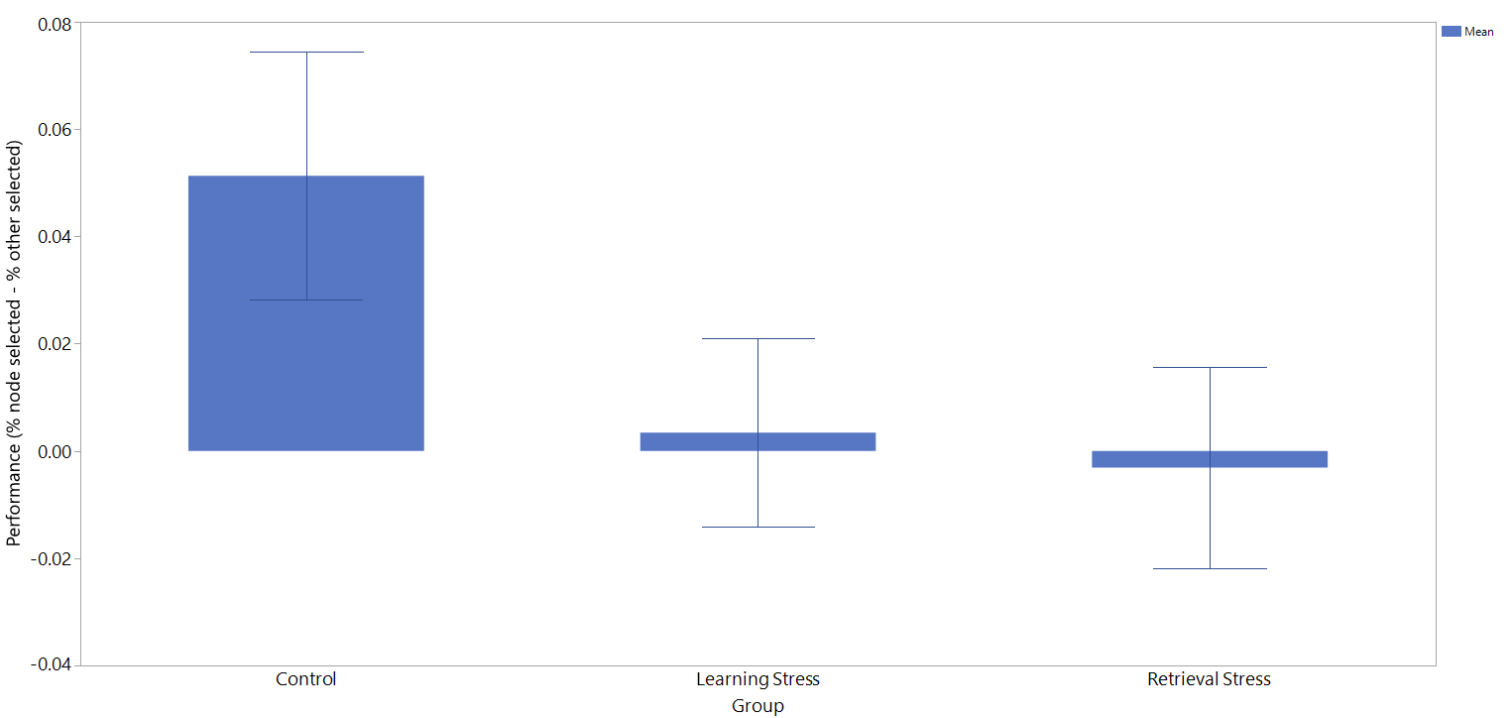

Slide 10
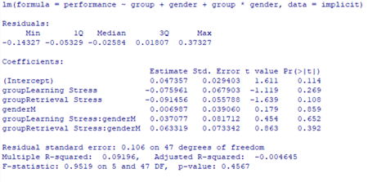
Linear Model Results
Notes:
Coefficients improve when stress groups are combined to a p-value of 0.102

Slide 11
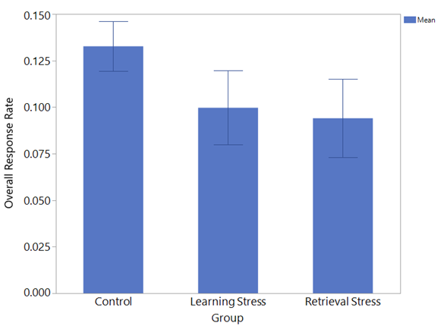
Notes:
Overall response rates of each group in the study. Appears it may be lower in the stress groups, but not statistically significant with the current sample.

Slide 12
Lag Measure
In control group, observed response one shape after transition more frequently than other responses
Quantified lag as no more than one shape, because average length spent in a community is small (6-7 shapes)
Parse on Step 2 would be considered a node response
Parse on Step 3 would be considered a lag response
1
2
3

Slide 13
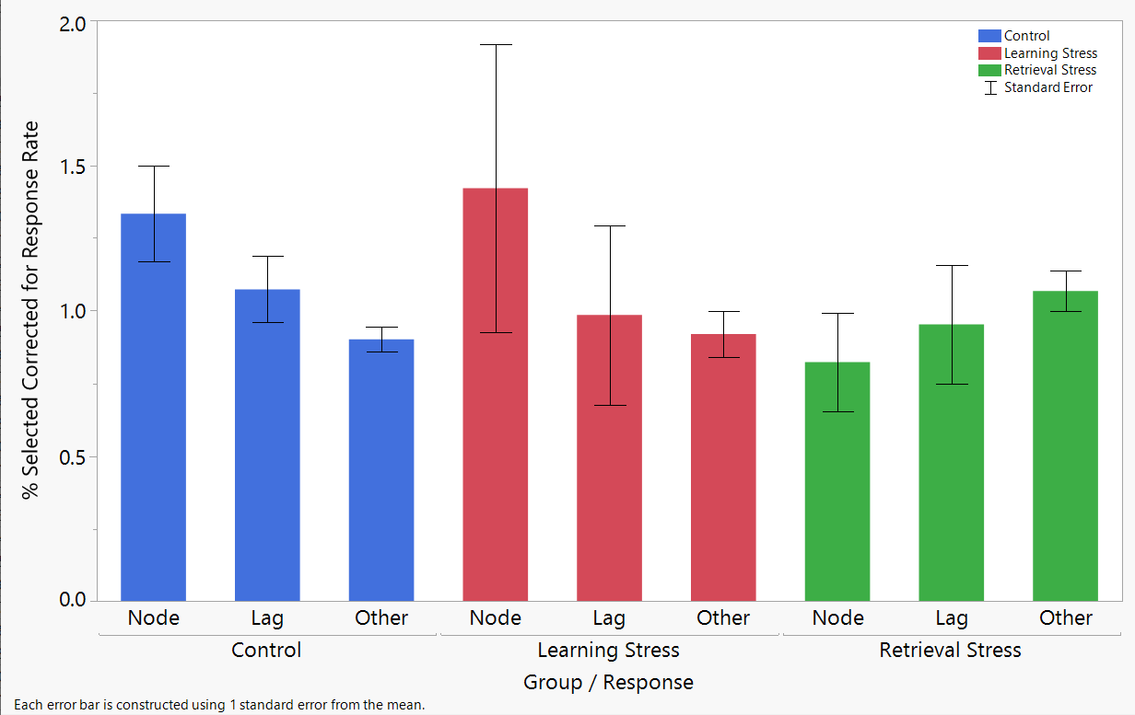

Slide 14
Other Analyses
Performance stayed consistent across trials
No relationship was found between the following variables
Explicit learning and implicit learning performance
Reported stress level and implicit learning performance
Masking task accuracy and implicit learning performance
Gender and implicit learning performance
Cortisol measures for the control group significantly decreased on average across measures
Suggests that the task itself is not inherently stress-inducing

Slide 15
Next Steps
Collect larger stress sample in the fall (Thanks for helping out, Avery!)
Pending normalcy, will be on campus to help out with training in August
Collect additional cortisol data
Conduct follow-up studies
Understand demographics/other causes for individual differences
Examine manipulations of learning context

Slide 16
References
1. Schapiro, A. C., Rogers, T. T., Cordova, N. I., Turk-Browne, N. B., & Botvinick, M. M. (2013). Neural representations of events arise from temporal community structure. Nature neuroscience, 16(4), 486.
2. Schapiro, A. C., Turk-Browne, N. B., Botvinick, M. M., & Norman, K. A. (2017). Complementary learning systems within the hippocampus: a neural network modeling approach to reconciling episodic memory with statistical learning. Philosophical Transactions of the Royal Society B: Biological Sciences, 372(1711), 20160049.
3. Schapiro, A. C., Gregory, E., Landau, B., McCloskey, M., & Turk-Browne, N. B. (2014). The necessity of the medial temporal lobe for statistical learning. Journal of cognitive neuroscience, 26(8), 1736-1747.
4. Gagnon, S. A., Waskom, M. L., Brown, T. I., & Wagner, A. D. (2018). Stress impairs episodic retrieval by disrupting hippocampal and cortical mechanisms of remembering. Cerebral cortex (New York, NY: 1991).

